Slide 1

Issues, Challenges, and Pitfalls in the Cyber Domain
Ms. Stacey Wright
Cybercrime Support Network
VP of Cyber Resiliency Services

Slide 2
AGENDA
Cybercrime Support Network
Unique Data Sharing Issues in Cyber
Information Sharing Pitfalls
Best Practices in Implementing Data Standards
Challenges of Emerging Technology

Slide 3


Cybercrime Support Network
Cybercrime Support Network (CSN) is a national nonprofit whose mission is to serve individuals and small businesses impacted by cybercrime.
Report.
Recover.
Reinforce.
Notes:
Mission
To serve individuals and small businesses impacted by cybercrime.
Vision A society where everyone has the knowledge, skills, and resources needed to recognize and defend against cybercrime.

Slide 4



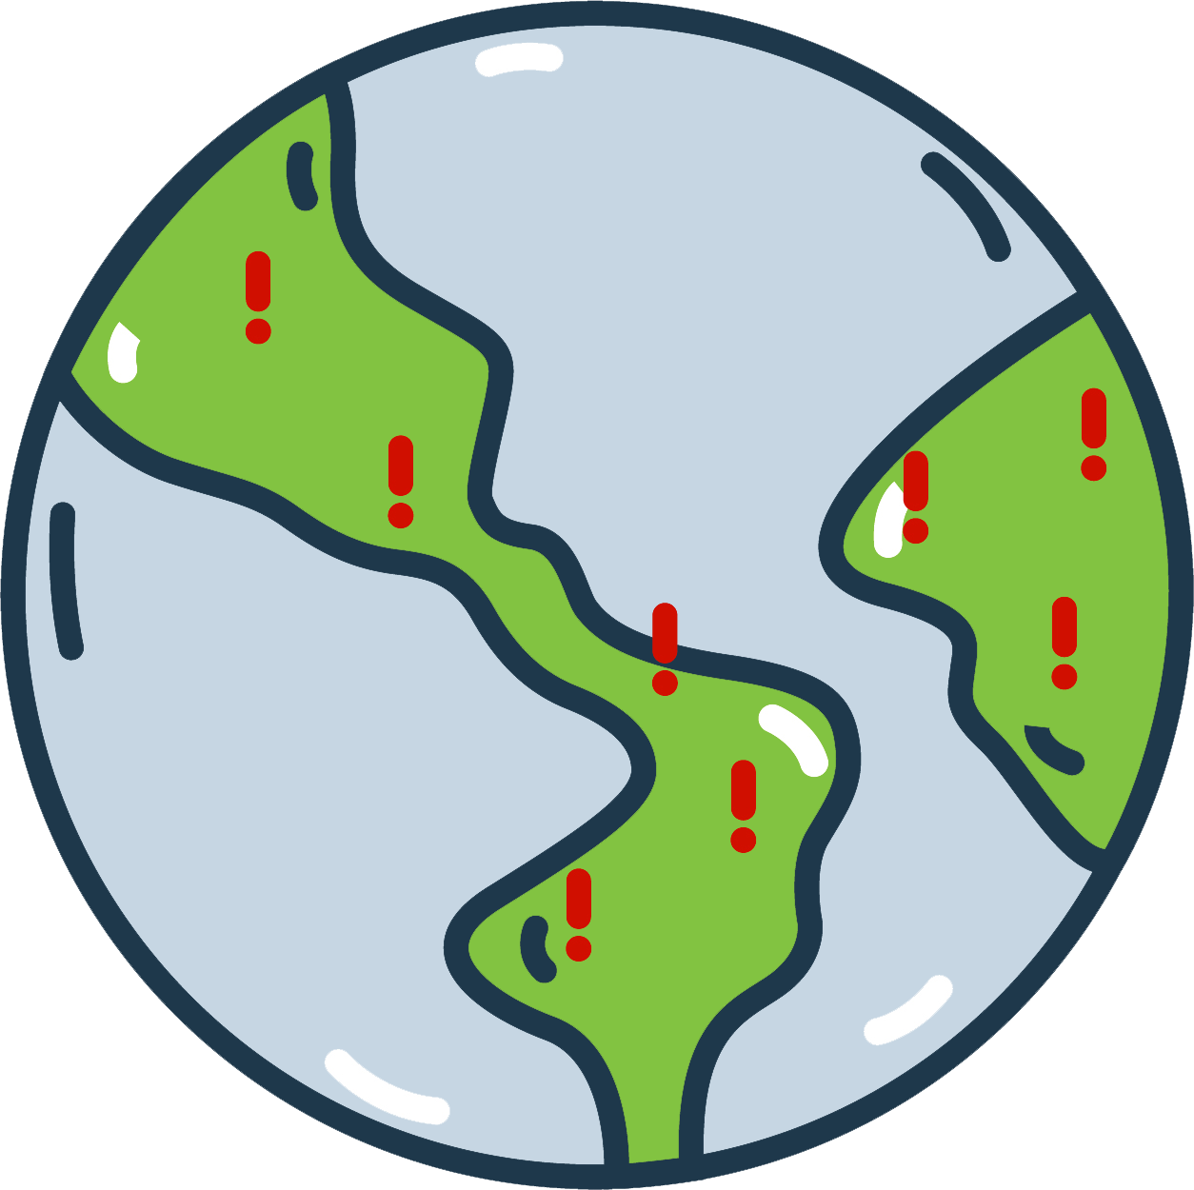
The Problem
Finding resources
Lack of reporting
Law enforcement & 9-1-1 do not have tools
Finding the criminal is hard

Slide 5
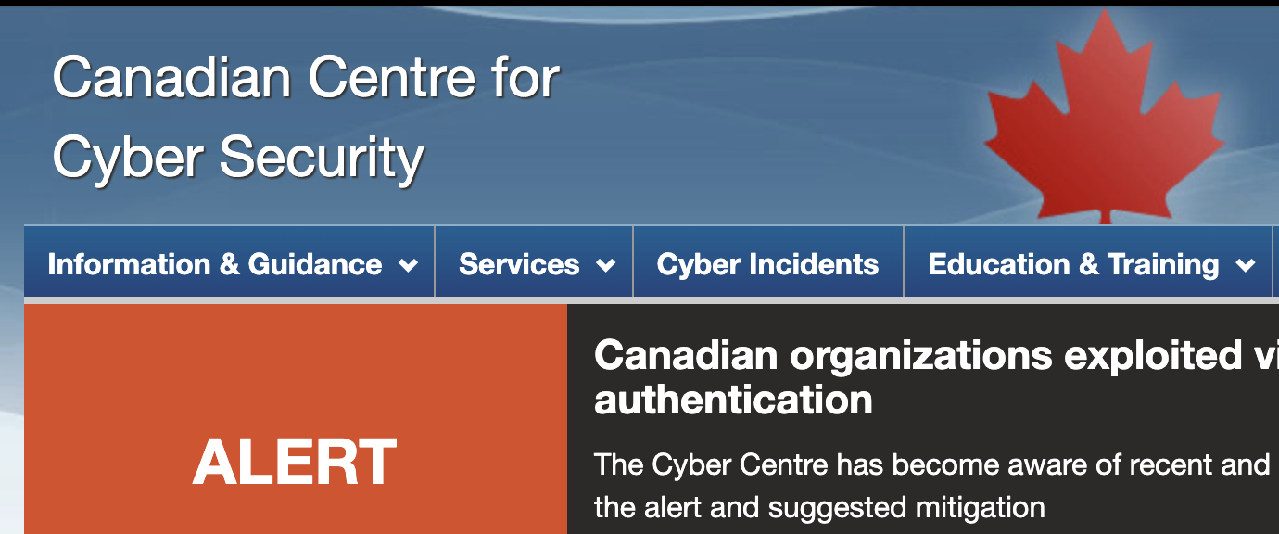
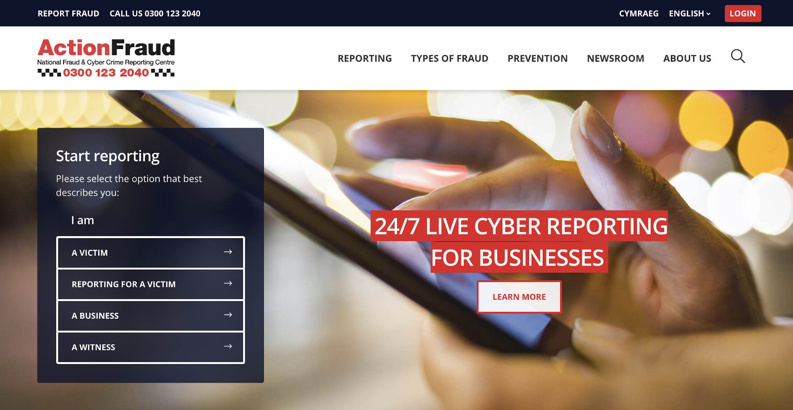

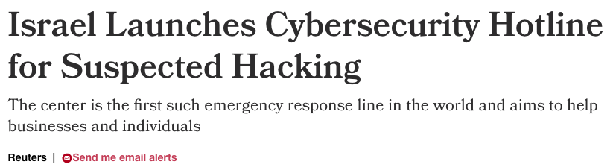
What does success look like?
Increased reporting
Increased recovery
Increased resources
Decreased crime and re-victimization
Notes:
When we are successful, we’ll see
Increased reporting
Increased recovery
Increased resources
And DECREASED crime and revictimization

Slide 6

CSN Is Helping Build the NIEM Cyber Domain
CSN was awarded a cooperative agreement from the Cybersecurity & Infrastructure Security Agency (CISA) to develop a State, Local, Tribal & Territorial (SLTT) NIEM Cyber Pilot
We are working with partners to extend the NIEM Cyber Domain
Goals are to…
Ensure the Cyber domain meets the needs of SLTT agencies
Encourage NIEM adoption among SLTT agencies
Create sets of Information Exchange Package Documentation (IEPDs) used to facilitate information exchange
Pilot the Cyber domain among SLTT agencies
Our focus is on incident response and cyber physical systems

Slide 7
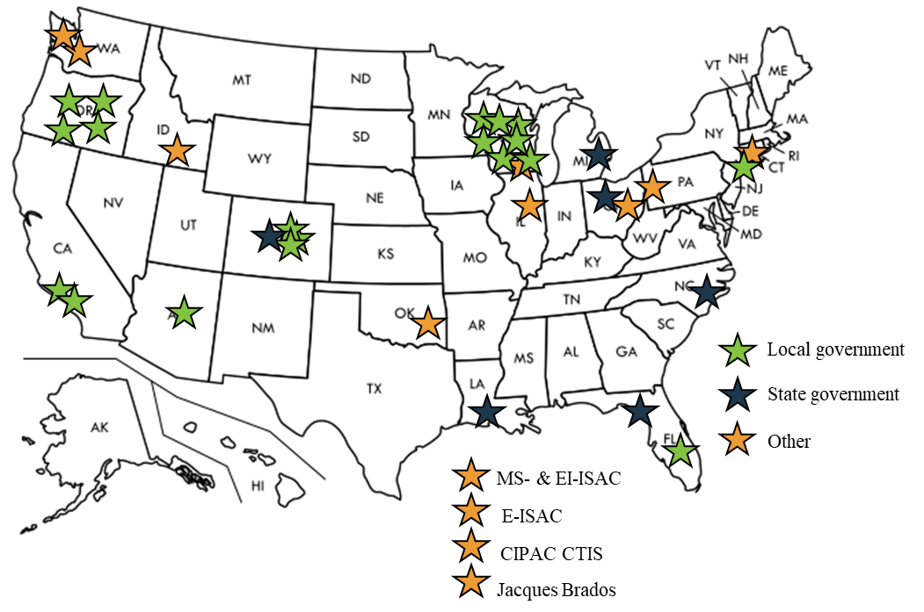
SLTT Stakeholders: 38
TLP:GREEN

Slide 8
Unique Data Sharing Issues in Cyber
Compliance driver requirements don’t match each other
Different purposes have led to different taxonomies and terms
Different maturity levels

Slide 9
Compliance Drivers Don’t Match
Protected Critical Infrastructure Information (PCII)
Federal Tax Information (FTI) under IRS1075
Personal Health Information (PHI)/electronic PHI (ePHI)
Federal Trade Commission’s (FTC) Health Breach Notification Rule.
FTC collects Children's Online Privacy Protection Act (COPPA)
Family Educational Rights and Privacy Act (FERPA)
Criminal Justice Information System (CJIS) and information incidents
Federal Energy Regulatory Commission (FERC)
North American Electricity Reliability Corporation (NERC)
ISACs, such as the Elections Infrastructure ISAC, Electricity ISAC, Health ISAC, Multi-State ISAC, and WaterISAC, and information sharing organizations, such as TribalNet
Payment Card Industry (PCI) Data Security Standard (DSS)
Local laws and regulations:
California Consumer Privacy Act (CCPA)
California Civil Code s. 1798.29(a) requires state agencies to disclose data breaches affecting unencrypted PII
Louisiana Cyber Incident Response Plan, Emergency Support Function 17 (ESF17)

Slide 10




Different Taxonomies
Ad hoc – self developed taxonomies and ontologies
STIX / TAXII
Structured Threat Information Expression (STIX™) is a language and serialization format used to exchange cyber threat intelligence (CTI).
Trusted Automated Exchange of Intelligence Information (TAXII™) is an application layer protocol for the communication of cyber threat information in a simple and scalable manner.
VERIS Framework
Vocabulary for Event Recording and Incident Sharing (VERIS) is a set of metrics designed to provide a common language for describing security incidents in a structured and repeatable manner.
Notes:
Ad hoc developments in SLTTs often have political histories – elected official made a law mandating the collection of <x>

Slide 11
Different Terms
cyber:MajorIncidentType
cyber:MajorIncidentDesignationReasonText cyber:CongressionalReport
cyber:CongressionalReportType
cyber:CyberIncidentReportedToCongressDateTime cyber:CyberIncidentReportedCongressionalCommitteeDescriptionText
cyber:CyberIncidentType (STIX)
cyber:IncidentOpenedDate (STIX) cyber:IncidentDiscoveryDate (STIX) cyber:SecurityEventIndicator cyber:MajorIncident cyber:SignificantIncident cyber:IncidentDowngradedReasonText cyber:IncidentUpdateReasonText cyber:IncidentFunctionalImpactDescriptionText cyber:HighValueAssetIndicator cyber:IncidentQualifyingActivityDescriptionText cyber:DomainName cyber:ObservedData cyber:AttackVector cyber:IncidentDiscoveryMethod (STIX) cyber:IncidentOccurredDescriptionText cyber:AttackPattern cyber:IncidentSeverity cyber:DeclarationOfEmergency cyber:Breach cyber:IncidentSystemImpact cyber:IncidentEndpointImpact cyber:IncidentInfectedDevice cyber:IncidentImpactedPlatform cyber:IncidentResponse cyber:CourseOfAction (STIX) cyber:IncidentConsequenceCategoryCode cyber:CyberIndicatorPattern cyber:Vulnerability cyber:Malware cyber:CompromisedCommunication cyber:UnattributedCyberIntrusion cyber:InformationExchangePolicy cyber:CyberAnalytic cyber:Responder (STIX) cyber:IncidentNotification cyber:CyberInsuranceClaim nc:Organization nc:ContactInformation ip:Sector nc:CaseTrackingID
A major incident is EITHER:
Any incident that is likely to result in demonstrable harm to the national security interests, foreign relations, or the economy of the United States or to the public confidence, civil liberties, or public health and safety of the American people. Agencies should determine the level of impact of the incident by using the existing incident management process established in National Institute of Standards and Technology (NIST) Special Publication (SP) 800-61, Computer Security Incident Handling Guide. Or
A breach that involves personally identifiable information (PII) that, if exfiltrated, modified, deleted, or otherwise compromised, is likely to result in demonstrable harm to the national security interests, foreign relations, or the economy of the United States, or to the public confidence, civil liberties, or public health and safety of the American people.
cyber:SignificantIncidentType
cyber:SignificantIncidentDesignator cyber:SignificantIncidentDesignationReasonText
Notes:
Reputation, financial, fear of further attacks (revenge),

Slide 12
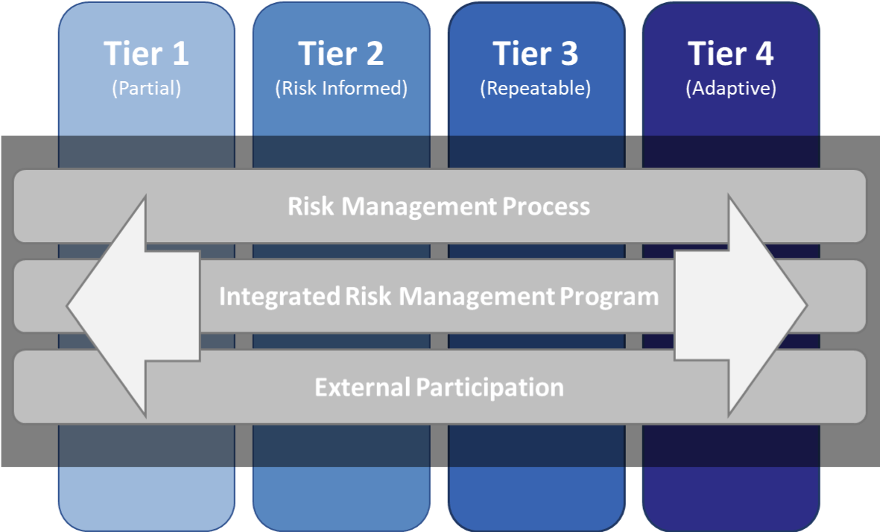
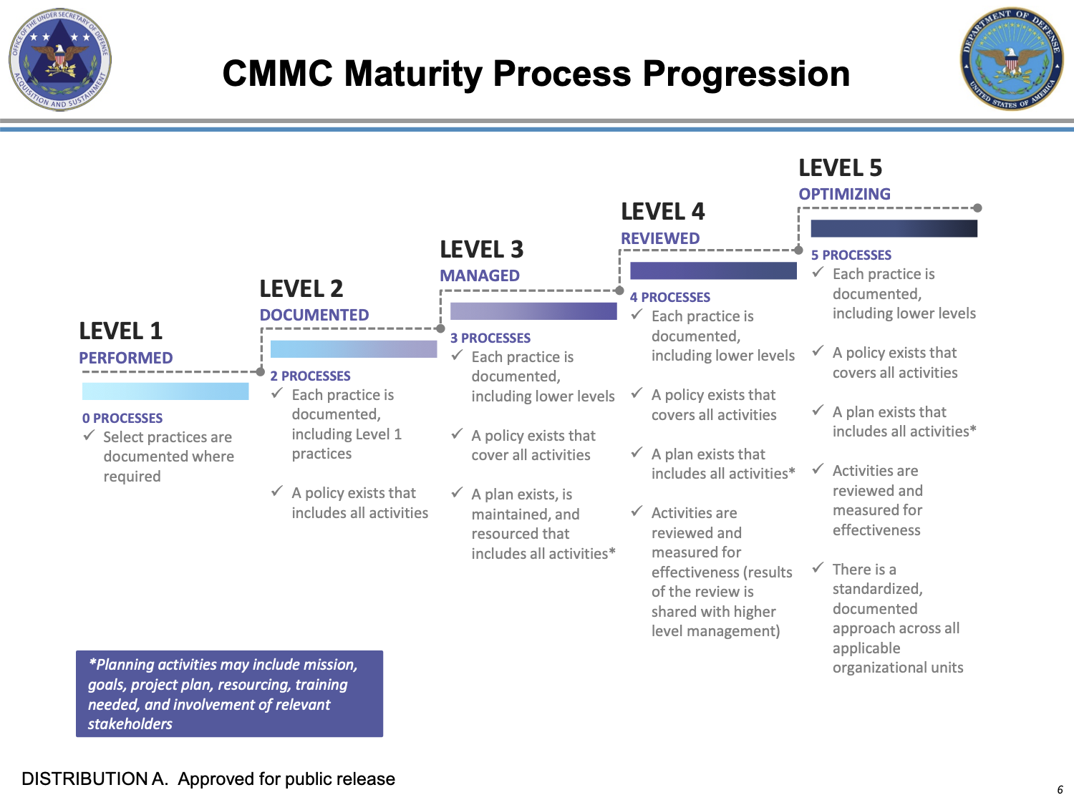
Different Maturity Levels
“Some small orgs even ask ‘what are IOCs’ [tactical intel] and ‘what do I do with them?’”
-SLTT NIEM Stakeholder
Capability to Send and Receive Information
Maturity Level |  | Sending Agency
 |  | Lower | Medium | Mature
Receiving Agency | Lower | Tactical | Tactical, Operational | Tactical, Operational, Strategic
 | Medium | Tactical | Tactical, Operational | Tactical, Operational, Strategic
 | Mature | Tactical | Tactical, Operational | Tactical, Operational, Strategic
Notes:
TOS in Cyber terms
Ad hoc developments in SLTTs often have political histories – elected official made a law mandating the collection of <x>
Cybersecurity Maturity Model Certification (CMMC) to normalize and standardize cybersecurity preparedness across the federal government's defense industrial base (DIB).

Slide 13
Information Sharing Pitfalls
Cyber incidents are not cyber crimes
POET (Political, Operational, Economic, and Technical)
Information sharing varies by network design, cardinality, and restrictions

Slide 14
Cyber Incidents ≠ Cyber Crimes
“There’s often an unhelpful conceptual distinction between ‘cyber incidents’ vs. ‘cyber crimes.’ [The lack of s]haring is still bad for both, but especially rare if there is no perceived loss or harm to a company that could constitute a crime. This is a missed opportunity since ‘cyber incidents’ including attempted crime/penetrations can still provide valuable insights for the larger cybersecurity community.”
-SLTT NIEM Stakeholder
Approaches to Cybercrime | Cyber-enabled crime | Cyber-native (dependent) crime
Malicious cyber activity | Doxing someone; Identifying targets for home robberies via social media; Using online street maps to plan a bank robbery | Writing malware code; Scanning a network for vulnerabilities or open ports; Failed credential stuffing attempts
Illegal cyber activity | Identity theft through misconfigured and exposed databases | Computer/network access and trespass (AKA intrusions); Malware deployment
Notes:
The bigger the sandbox, the less specificity

Slide 15

Political, Operational, Economic, and Technical
cyber:DeclarationOfEmergencyType
cyber:DeclarationOfEmergencyDesignator cyber:ResourceDeploymentReasonText nc:StartDate nc:EndDate
cyber:CyberIncidentType (STIX)
cyber:IncidentOpenedDate (STIX) cyber:IncidentDiscoveryDate (STIX) cyber:SecurityEventIndicator cyber:MajorIncident cyber:SignificantIncident cyber:IncidentDowngradedReasonText cyber:IncidentUpdateReasonText cyber:IncidentFunctionalImpactDescriptionText cyber:HighValueAssetIndicator cyber:IncidentQualifyingActivityDescriptionText cyber:DomainName cyber:ObservedData cyber:AttackVector cyber:IncidentDiscoveryMethod (STIX) cyber:IncidentOccurredDescriptionText cyber:AttackPattern cyber:IncidentSeverity cyber:DeclarationOfEmergency cyber:Breach cyber:IncidentSystemImpact cyber:IncidentEndpointImpact cyber:IncidentInfectedDevice cyber:IncidentImpactedPlatform cyber:IncidentResponse cyber:CourseOfAction (STIX) cyber:IncidentConsequenceCategoryCode cyber:CyberIndicatorPattern cyber:Vulnerability cyber:Malware cyber:CompromisedCommunication cyber:UnattributedCyberIntrusion cyber:InformationExchangePolicy cyber:CyberAnalytic cyber:Responder (STIX) cyber:IncidentNotification cyber:CyberInsuranceClaim nc:Organization nc:ContactInformation ip:Sector nc:CaseTrackingID
2020
hack
Software Bill of Materials (SBOM)
Executive Order on Improving the Nation’s Cybersecurity, May 12, 2021
Sec. 4. Enhancing Software Supply Chain Security
(e) Within 90 days of publication of the preliminary guidelines pursuant to subsection (c) of this section, the Secretary of Commerce acting through the Director of NIST, in consultation with the heads of such agencies as the Director of NIST deems appropriate, shall issue guidance identifying practices that enhance the security of the software supply chain.
(vii) providing a purchaser a Software Bill of Materials (SBOM) for each product directly or by publishing it on a public website;

Slide 16
Political, Operational, Economic, and Technical
cyber:CyberIncidentType (STIX)
cyber:IncidentOpenedDate (STIX) cyber:IncidentDiscoveryDate (STIX) cyber:SecurityEventIndicator cyber:MajorIncident cyber:SignificantIncident cyber:IncidentDowngradedReasonText cyber:IncidentUpdateReasonText cyber:IncidentFunctionalImpactDescriptionText cyber:HighValueAssetIndicator cyber:IncidentQualifyingActivityDescriptionText cyber:DomainName cyber:ObservedData cyber:AttackVector cyber:IncidentDiscoveryMethod (STIX) cyber:IncidentOccurredDescriptionText cyber:AttackPattern cyber:IncidentSeverity cyber:DeclarationOfEmergency cyber:Breach cyber:IncidentSystemImpact cyber:IncidentEndpointImpact cyber:IncidentInfectedDevice cyber:IncidentImpactedPlatform cyber:IncidentResponse cyber:CourseOfAction (STIX) cyber:IncidentConsequenceCategoryCode cyber:CyberIndicatorPattern cyber:Vulnerability cyber:Malware cyber:CompromisedCommunication cyber:UnattributedCyberIntrusion cyber:InformationExchangePolicy cyber:CyberAnalytic cyber:Responder (STIX) cyber:IncidentNotification cyber:CyberInsuranceClaim nc:Organization nc:ContactInformation ip:Sector nc:CaseTrackingID
cyber:CyberInsuranceClaimType
cyber:InsuranceClaimFiledIndicator cyber:InsuranceResponseIndicator cyber:InsuranceClaimResponseCategoryCode cyber:InsuranceResponseShareIndicator cyber:InsuranceResponseSharingDescriptionText
“I have seen a clause in a cyber insurance contract for a private agency recently where if the agency shared any information, they would forfeit the right to file a claim.”
-SLTT NIEM Stakeholder

Slide 17
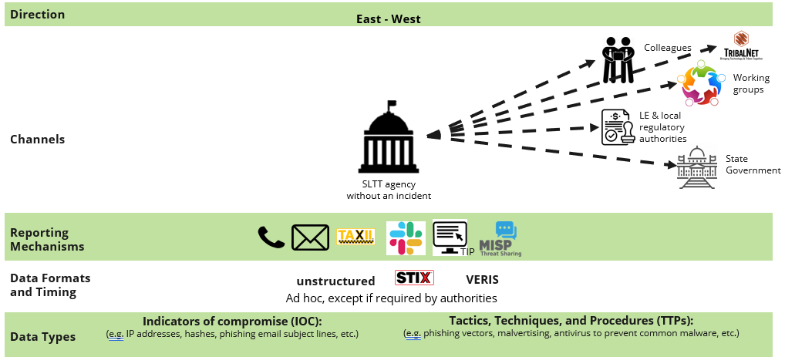
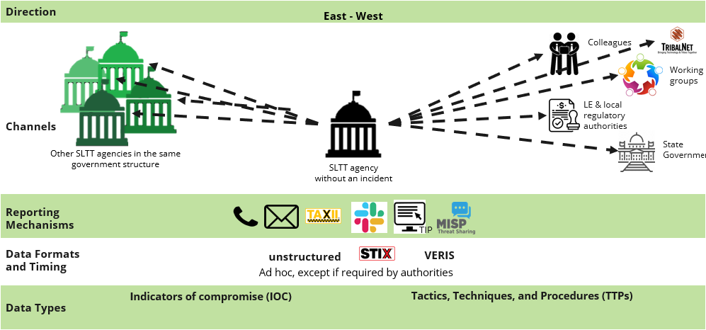
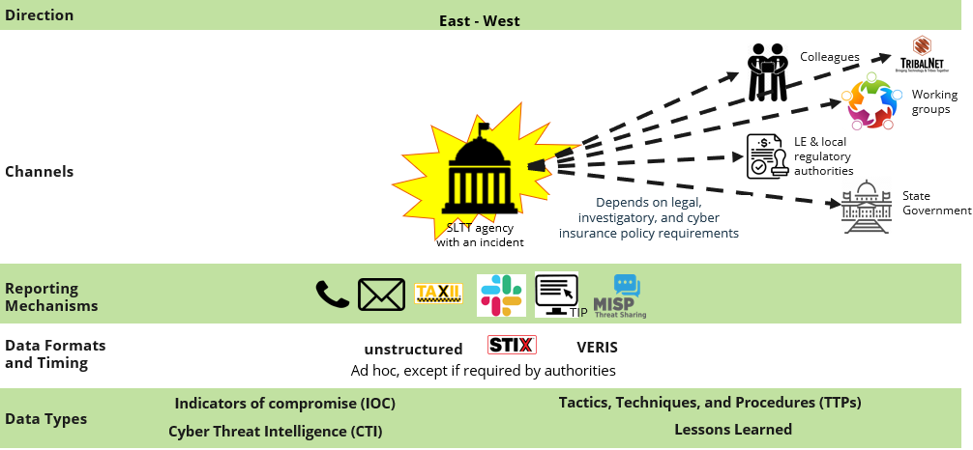
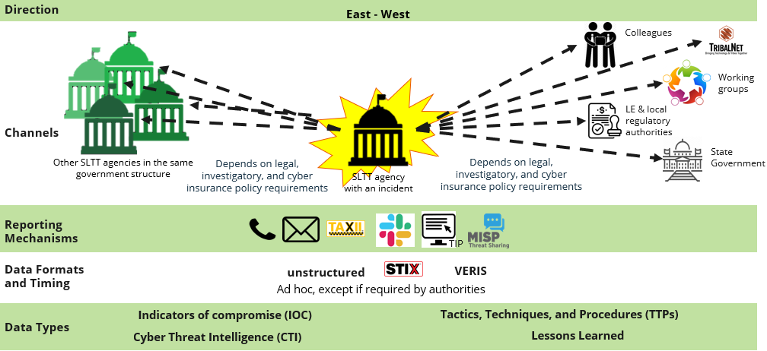
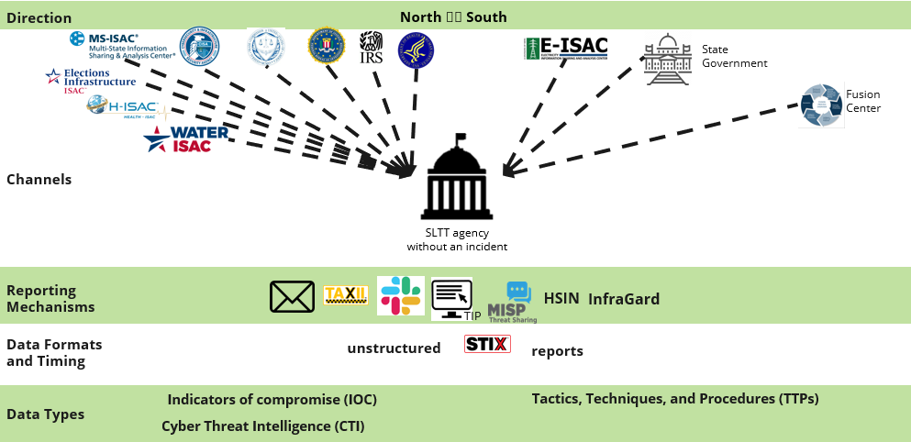
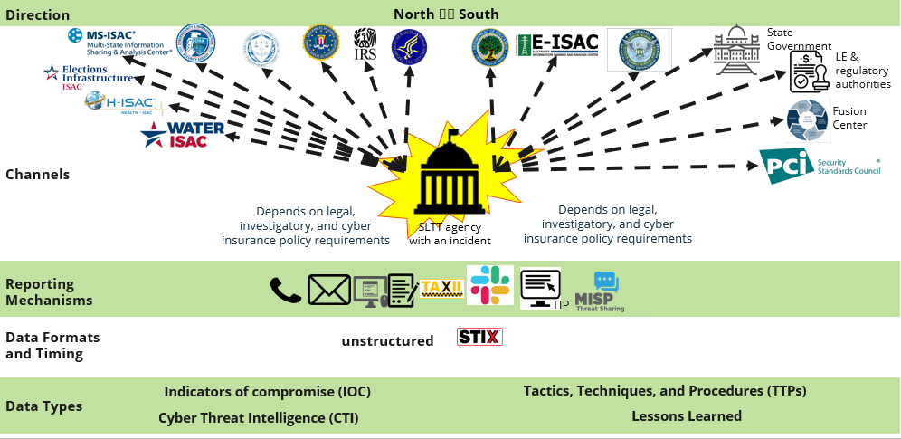
Network Design & Cardinality
Network Types:
Centralized
Decentralized
Distributed
With an incident is different than without an incident
Compliance Drivers:
Federal Government
SLTT Government
Private Industry

Slide 18
Best Practices in Implementing Data Standards
Existing data standards, schemas, frameworks, and other considerations
Security and privacy are key

Slide 19
Existing Data Standards, Schemas, Frameworks, Considerations…
Anti-Phishing Working Group (APWG) proposed schema for expressing sharing designations
Common Attack Pattern Enumeration and Classification (CAPEC)
Common Configuration Enumeration (CCE)
Common Configuration Scoring System CCSS Specification
Common Platform Enumeration (CPE)
Common Vulnerability Enumeration (CVE)
Common Vulnerability Reporting Framework (CVRF)
Common Vulnerability Scoring System (CVSS)
Common Weakness Scoring System (CWSS™)
Common Weakness Enumeration (CWE™)
Common Weakness Risk Analysis Framework (CWRAF™)
Cybersecurity Information Exchange Framework (CYBEX)
DMTF (formerly known as the Distributed Management Task Force) Common Information Model (CIM).
FIRST Information Exchange Policy (IEP).
Internet Engineering Task Force (IETF) Resource-Oriented Lightweight Information Exchange (ROLIE)
Incident Object Description Exchange Format (IODEF) [RFC 5070]
IETF’s Managed Incident Lightweight Exchange (MILE)
Knowledge Discovery Metamodel (KDM)
Malware Attribute Enumeration and Characterization (MAEC)
Malware Information Sharing and Threat Intelligence Sharing Platform (MISP)
NIST’s Asset Summary Reporting (ASR)
OASIS Open Cybersecurity Alliance (OCA)
OASIS Application Vulnerability Description Language (AVDL)
Open Security Controls Assessment Language (OSCAL)
Open Vulnerability and Assessment Language (OVAL®).
Open Checklist Interactive Language (OCIL)
OpenIOC
Policy Language for Assessment Results Reporting (PLARR)
Real-time Inter-network Defense (RID) (IETF/RFC)
Transport of Real-time Inter-network Defense (RID-T) Messages (IETF/RFC)
Software Identification (SWID) Specification (ISO 19770-2)
Structured Threat Information Expression (STIXTM)/Trusted Automated Exchange of Intelligence Information (TAXIITM)
Security Content Automation Protocol (SCAP)
Assessment Results Format (ARF)
ARF Structured Assurance Case Metamodel (SACM) Specification (OMG)
VERIS (vocabulary for event recording and incident sharing)
eXtensible Configuration Checklist Description Format (XCCDF)

Slide 20
Security and Privacy
cyber:CyberIndicatorType (STIX)
cyber:CyberIndicatorName (STIX) cyber:CyberIndicatorDescriptionText (STIX) cyber:CyberIndicatorDefensiveMeasureText cyber:CyberIndicatorDefensiveMeasureComplianceIndicator cyber:KillChainPhase cyber:TrafficLightProtocolCode cyber:CyberIndicatorDiamondModelClassificationCode
cyber:CyberIncidentType (STIX)
cyber:IncidentOpenedDate (STIX) cyber:IncidentDiscoveryDate (STIX) cyber:SecurityEventIndicator cyber:MajorIncident cyber:SignificantIncident cyber:IncidentDowngradedReasonText cyber:IncidentUpdateReasonText cyber:IncidentFunctionalImpactDescriptionText cyber:HighValueAssetIndicator cyber:IncidentQualifyingActivityDescriptionText cyber:DomainName cyber:ObservedData cyber:AttackVector cyber:IncidentDiscoveryMethod (STIX) cyber:IncidentOccurredDescriptionText cyber:AttackPattern cyber:IncidentSeverity cyber:DeclarationOfEmergency cyber:Breach cyber:IncidentSystemImpact cyber:IncidentEndpointImpact cyber:IncidentInfectedDevice cyber:IncidentImpactedPlatform cyber:IncidentResponse cyber:CourseOfAction (STIX) cyber:IncidentConsequenceCategoryCode cyber:CyberIndicatorPattern cyber:Vulnerability cyber:Malware cyber:CompromisedCommunication cyber:UnattributedCyberIntrusion cyber:InformationExchangePolicy cyber:CyberAnalytic cyber:Responder (STIX) cyber:IncidentNotification cyber:CyberInsuranceClaim nc:Organization nc:ContactInformation ip:Sector nc:CaseTrackingID
Color | When should it be used? | How may it be shared?
TLP:RED Not for disclosure, restricted to participants only. | Sources may use TLP:RED when information cannot be effectively acted upon by additional parties, and could lead to impacts on a party's privacy, reputation, or operations if misused. | Recipients may not share TLP:RED information with any parties outside of the specific exchange, meeting, or conversation in which it was originally disclosed. In the context of a meeting, for example, TLP:RED information is limited to those present at the meeting. In most circumstances, TLP:RED should be exchanged verbally or in person.
TLP:AMBER Limited disclosure, restricted to participants’ organizations. | Sources may use TLP:AMBER when information requires support to be effectively acted upon, yet carries risks to privacy, reputation, or operations if shared outside of the organizations involved. | Recipients may only share TLP:AMBER information with members of their own organization, and with clients or customers who need to know the information to protect themselves or prevent further harm. Sources are at liberty to specify additional intended limits of the sharing: these must be adhered to.
TLP:GREEN Limited disclosure, restricted to the community. | Sources may use TLP:GREEN when information is useful for the awareness of all participating organizations as well as with peers within the broader community or sector. | Recipients may share TLP:GREEN information with peers and partner organizations within their sector or community, but not via publicly accessible channels. Information in this category can be circulated widely within a particular community. TLP:GREEN information may not be released outside of the community.
TLP:WHITE Disclosure is not limited. | Sources may use TLP:WHITE when information carries minimal or no foreseeable risk of misuse, in accordance with applicable rules and procedures for public release. | Subject to standard copyright rules, TLP:WHITE information may be distributed without restriction.
Notes:
Reputation, financial, fear of further attacks (revenge),
32 CFR Part 310 - PROTECTION OF PRIVACY AND ACCESS TO AND AMENDEMENT OF INDIVIDUAL RECORDS UNDER THE PRIVACY ACT OF 1974
Freedom of Information Act (FOIA) / Laws (FOIL)

Slide 21
Challenges of Emerging Technology
Rapid evolution of technology
Rapid evolution of crime

Slide 22

Rapid Evolution of Technology
The Unknown
As we know,
There are known knowns.
There are things we know we know.
We also know
There are known unknowns.
That is to say
We know there are some things
We do not know.
But there are also unknown unknowns,
The ones we don’t know
We don’t know.
— Donald H. Rumsfeld, Secretary of Defense Feb. 12, 2002, Department of Defense news briefing

Slide 23
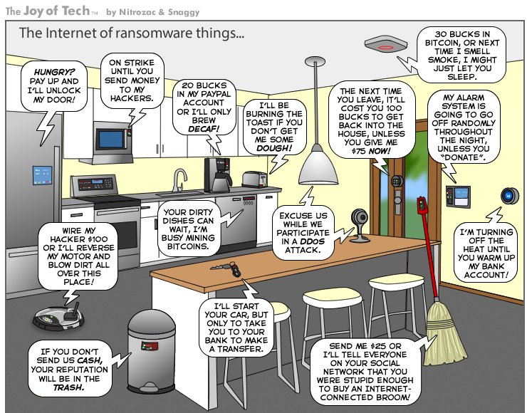
Rapid Evolution of Crime

Slide 24
NIEM SLTT CPS Scope
Sector | Priority 1 CPS 1. known cyber incidents involve these devices to significant effect, or 2. compliance drivers mandate knowledge | Priority 2 CPS 1. known cyber incidents involve these devices to limited effect, or 2. high potential for targeting with high integration in SLTTs | Priority 3 CPS 1. Medium potential for targeting with at least medium integration in SLTTs and theoretical incident affects | Not Included 1. known or theoretical cyber incidents involve these devices to minimal or no effect, or 2. Low priority for targeting, or 3. Low integration in SLTTs
Communications |  | Reverse 9-1-1 systems/IPAWS related | Public access network | Smart speakers
Dams | Chemical concentration sensors; Hydroelectric power sensors, controllers |  | Water level sensors
Emergency Services Sector | Emergency sirens | UAVs | Fingerprint machines in PDs | License plate readers (LPRs), Gunshot detectors
Energy | Electricity generation and distribution sensors, actuators, controllers, SCADAs, HMIs, and other ICS |  | Vehicle charging stations; Fuel pumps
Financial Services | POS systems | ATMs; Gaming machines; Money counters | Tax return scanners; check printers | Parking meters
Government Facilities | HVACs; Door locks/badging/access control systems; Voting machines; Ballot readers/ tabulators | Smart parking meters; Cameras; Elevators | Light system; Fire sensing and suppression systems | Bed bug monitors; Hotel reservation integration system
Healthcare and Public Health | Medical pumps | Defibrillators; Imaging systems; Lab equipment | Refrigeration temperature monitor; Pharmacy robot arms | Wearable health devices (e.g., Fitbit)
Transportation Systems | Pass readers (metros); Self-driving cars | Toll systems; Traffic lights; Air entry/air exit systems; Digital license plates | Vehicle sensors; Air ground traffic automation
Water and Wastewater | Chemical sensors; Fluid and solid valve controllers; Pump controllers; SCADAs, HMIs, and other ICS |  | Water meters

Slide 25

Thank You!
Stacey Wright
SWright@cybercrimesupport.org
Ilene Klein
ilene@cybercrimesupport.org
David Wagner
davidw@cybercrimesupport.org
Cybercrimesupport.org
FraudSupport.org
ScamSpotter.org
YouTube:
Cybercrime Support Network
Twitter:
@FraudSupport
@CyberSupportNet

